Slide 1
Fully Supervised Speaker Diarization Say Goodbye to clustering
Authors: Aonan Zhang, Quan Wang, Zhenyao Zhu,
John Paisley, Chong Wang
Presented by: Quan Wang
Notes:
Paper: https://arxiv.org/abs/1710.10467

Slide 2
Part 1:
Introduction

Slide 3
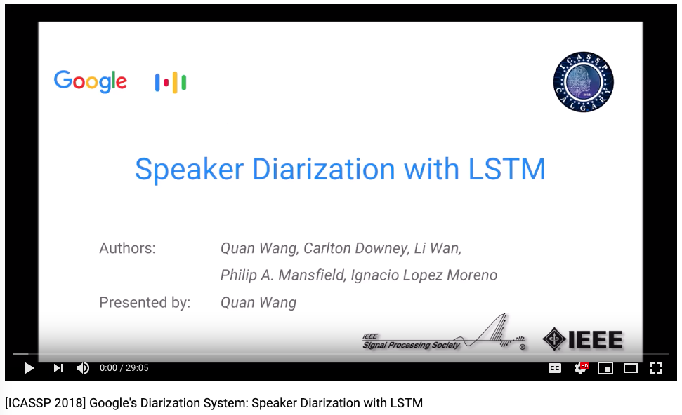
Prerequisite: Watch this video first
https://www.youtube.com/watch?v=pjxGPZQeeO4

Slide 4
Recap: What is speaker diarization?
The process of partitioning an input audio stream into homogeneous segments according to the speaker identity
“Who Spoke When?”
Speaker 1
Speaker 2

Slide 5
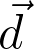
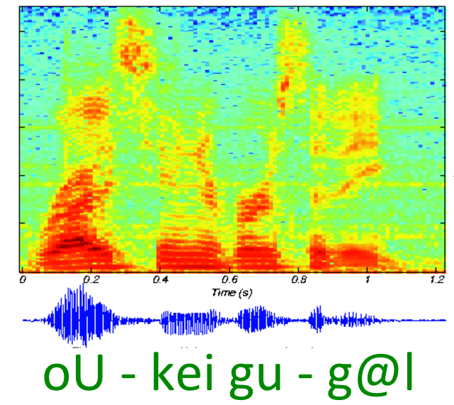
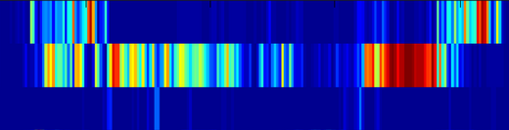
Recap: Speaker recognition with d-vector
LSTM
Cell
LSTM
Cell
LSTM
Cell
LSTM
Cell
LSTM
Cell
LSTM
Cell
LSTM
Cell
LSTM
Cell
LSTM
Cell
Fixed-length segment
Multi-layer LSTM network
D-vector
Wan, Li, Quan Wang, Alan Papir, and Ignacio Lopez Moreno. “Generalized end-to-end loss for speaker verification.” In 2018 IEEE International Conference on Acoustics, Speech and Signal Processing (ICASSP), pp. 4879-4883. IEEE, 2018.

Slide 6
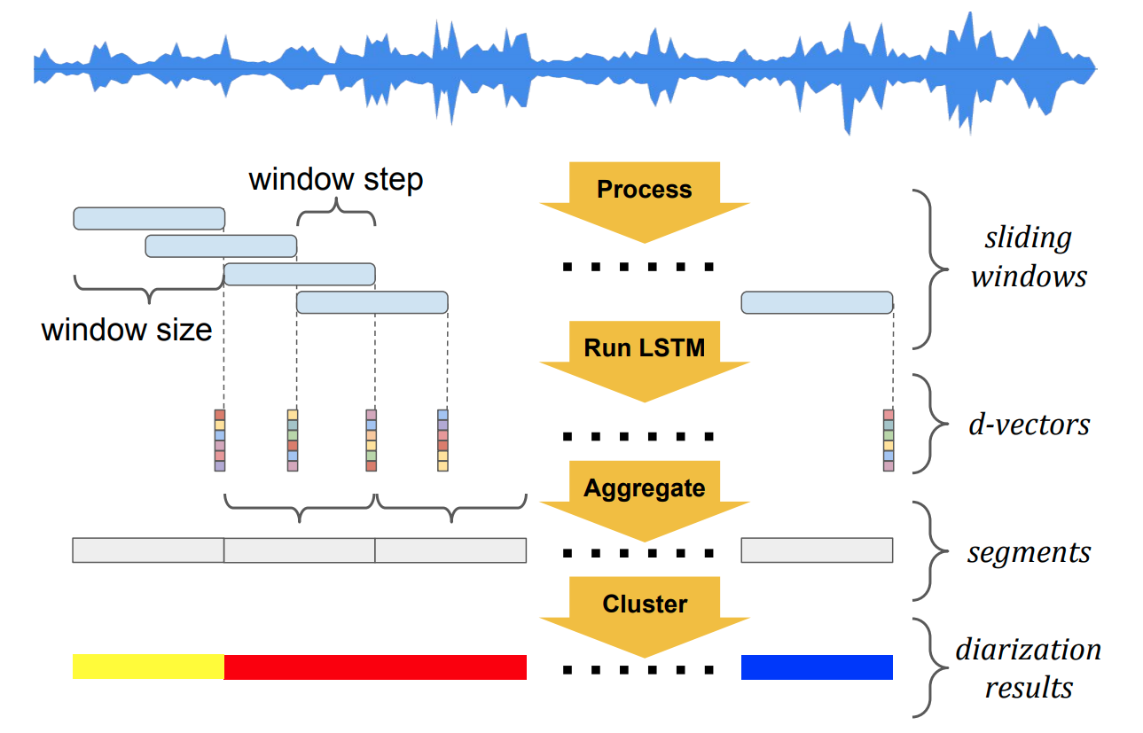
Recap: Baseline diarization system
Wang, Quan, Carlton Downey, Li Wan, Philip Andrew Mansfield, and Ignacio Lopz Moreno. “Speaker diarization with LSTM.” In 2018 IEEE International Conference on Acoustics, Speech and Signal Processing (ICASSP), pp. 5239-5243. IEEE, 2018.

Slide 7
Part 2:
Clustering - Why it’s not good enough?

Slide 8
Popular clustering algorithms in diarization
GMM
Mean shift
Hierarchical
K-Means
Spectral
Figure. Examples of different clustering algorithms in scikit-learn.

Slide 9
How many clusters?
training examples

Slide 10
How many clusters?
training examples

Slide 11


The order matters!

Slide 12
What clustering cannot do?
Learn from examples
Clustering algorithms are usually based on heuristics and rules
Incorporate temporal information
Most clustering algorithms are order-agnostic

Slide 13
The trend in speech: Supervised, RNN, end-to-end loss
Speech recognition:
Connectionist temporal classification (CTC)
Listen, Attend and Spell (LAS)
seq-to-seq
Speech synthesis:
Tacotron (seq-to-seq)
Machine translation:
GNMT (seq-to-seq)

Slide 14
Supervised diarization
Speech signals
Timestamped
speaker labels
“A”, t₀, t₁
“B”, t₁, t₂
“A”, t₂, t₃
“B”, t₃, t₄
“A”, t₄, t₅
Our mission:
Make full use of the speaker labels and their timestamps in the training data
This kind of labels are usually available in domain-specific applications

Slide 15
Supervised diarization
Speech signals
Timestamped
speaker labels
“A”, t₀, t₁
“B”, t₁, t₂
“A”, t₂, t₃
“B”, t₃, t₄
“A”, t₄, t₅
Our non-mission:
Train a model with data from one domain, and expect it to work well for all domains

Slide 16
Part 3:
UIS-RNN

Slide 17
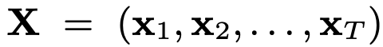
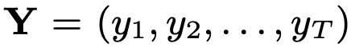
Notations
Observation sequence: embeddings of one utterance
Label sequence: speakers for the embeddings
Speaker change indicators

Slide 18
Example
An utterance with 6 embeddings from 3 speakers:
Y=(1, 1, 2, 3, 2, 2)
Speaker changes:
Z=(0, 1, 1, 1, 0)
Z can be uniquely determined by Y; but NOT the other way
1 1 2 3 2 2
\ / \ / \ / \ / \ /
0 1 1 1 0

Slide 19
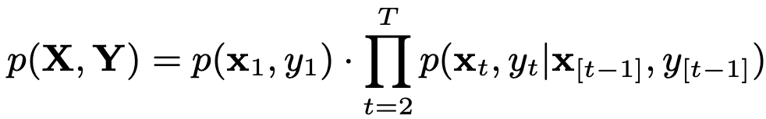
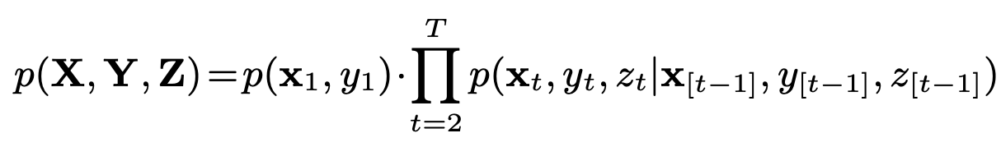
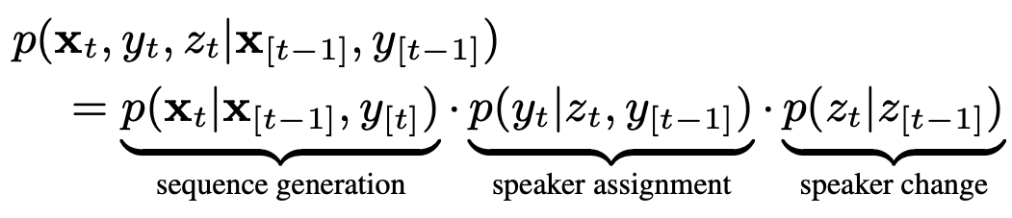
Target
UIS-RNN models the generative process of utterance (X, Y):
We augment the equation by including z:
We break each term to 3 components:

Slide 20
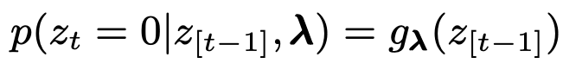
Speaker change: Generic form
Speaker change is a distribution:
It models how likely the current speaker would change (z_{t}=1)
It depends on previous speaker changes (z_{[t-1]})
It has the generic form:
E.g. g _{𝛌}(⋅) could be a RNN parameterized by 𝛌

Slide 21
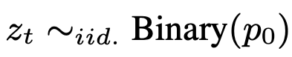

Speaker change: Simplest form
For simplicity, our implementation uses I.I.D. distribution
Only one parameter here: 𝛌={p₀}
In other words, we model speaker change by a coin flipping process

Slide 22
Speaker assignment
If speaker has changed, which speaker is it?
New unseen speaker?
Previous seen speaker?
We model this process by a Chinese restaurant process (CRP)

Slide 23
Chinese restaurant process
Table 1
Table 2
Table 3
Table 4
Imagine you go to a restaurant, which table will you join?
Some probability to start a new table (you are the first to the party!)
Otherwise, more likely to join a table with more people (your party has started for a while!)

Slide 24
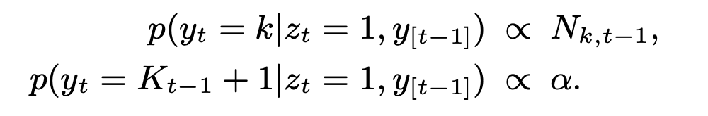
Speaker assignment: Formulations
Back to the speaker diarization problem, if speaker has changed:
First equation: assign to previous seen speaker
Second equation: assign to new unseen speaker
N_{k,t-1}: Number of blocks for speaker k in y_{[t-1]}
Y=(1, 1, 2, 3, 2, 2)
Speaker 1: 1 block
Speaker 2: 2 blocks
Speaker 3: 1 block
one block
one block

Slide 25
Speaker assignment: Heuristics
The person who leads the majority of the conversation, will more likely speak again
The person who often interrupts others, will more likely jump in again
In a specific domain, the probability for a new person to join is relatively stable
Telephone call: Not very likely
Meeting: Mildly likely
YouTube/Movie: Very likely

Slide 26
Sequence generation
Finally, we need to model p(x_{[t]}|x_{[t-1]},y_{[t]}):
Assumption 1: For each speaker, his/her embeddings are generated by an RNN instance
Assumption 2: Different speakers share the same RNN topology/parameters
Assumption 3: Each RNN instance has its own states

Slide 27
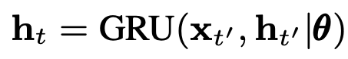
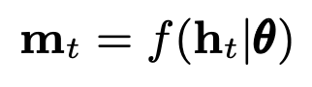
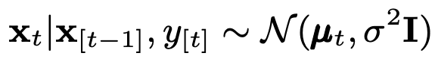
Sequence generation
Assume the network with parameter set θ has a GRU :
The network also has an output layer:
The sequence generation distribution is:
Last time we
see this speaker

Slide 28
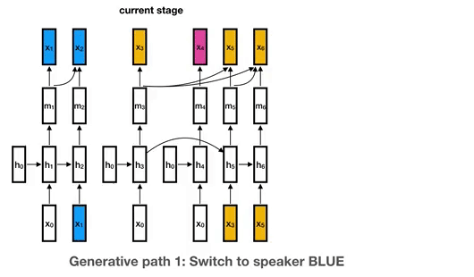
Summary of UIS-RNN
At time t, assume we have already seen k speakers in [t-1]:
k RNN instances that have been initialized
One more un-initialized RNN instance for a new speaker
k+1 possible generative paths in total for time t

Slide 29
Why the name?
Unbounded interleaved-state RNN
Unbounded: With Chinese restaurant process, we can produce unbounded number of speakers
Interleaved-state: States of different RNN instances interleave in the time domain

Slide 30
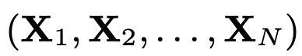
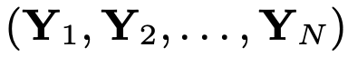
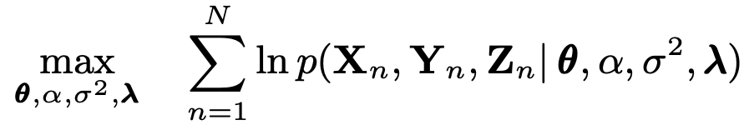
Training
Given the training data of N utterances:
We maximize the log joint likelihood (MLE estimation):

Slide 31
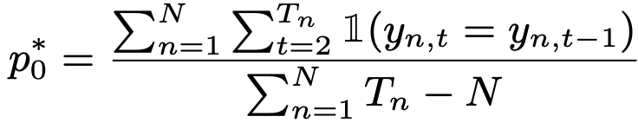
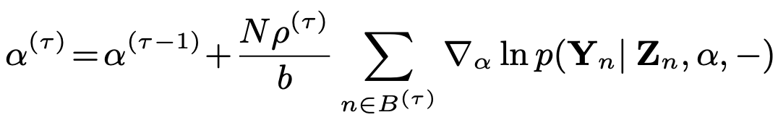
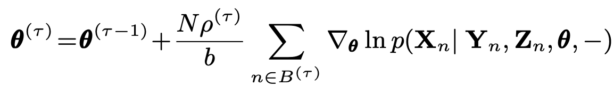
Training
Speaker change: deterministic estimation
Speaker assignment: gradient ascent
Sequence generation: gradient ascent

Slide 32
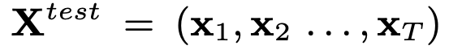
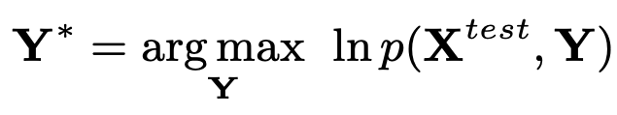
Decoding: The generic solution
Given a test utterance:
We want to find MAP solution:
The complexity is O(T!)

Slide 33
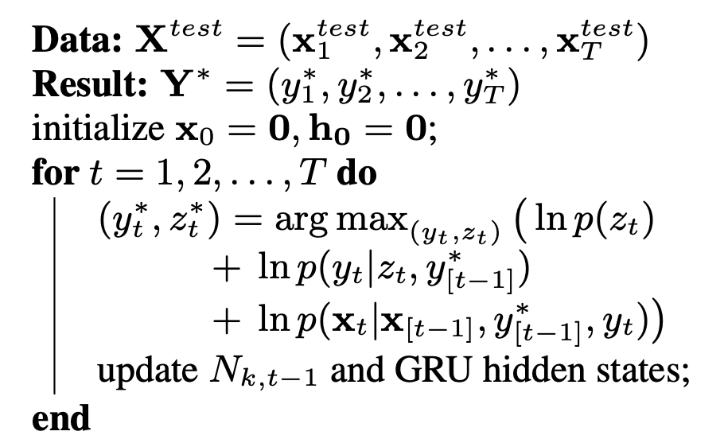
Decoding: The practical solution
In practice, we use a greedy online decoding, which is O(T²)
We can constrain the max number of speakers per utterance: O(T)
For better performance:
Beam search
Look aheads

Slide 34
Part 4:
Experimental Results

Slide 35
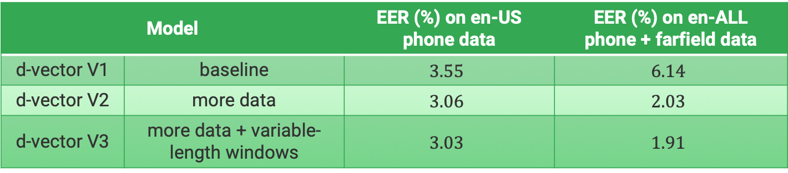
Speaker recognition model
We made several improvements over previous model:
More training data: non-US English, farfield, LibriSpeech, VoxCeleb 1&2
Variable-length windows for training: from 1600ms to [240ms, 1600ms]
Model |  | EER (%) on en-US phone data | EER (%) on en-ALL phone + farfield data
d-vector V1 | baseline | $$3.55$$ | $$6.14$$
d-vector V2 | more data | $$3.06$$ | $$2.03$$
d-vector V3 | more data + variable-length windows | $$3.03$$ | $$1.91$$

Slide 36
Diarization evaluation protocol
We use pyannote.metrics library
Overlapped speech is excluded from evaluation
We tolerate errors less than 250ms (the collar value)
We report confusion errors (referred to as DER in literature)

Slide 37
Datasets
We use 3 datasets:
NIST SRE 2000 Disk-8, a.k.a. CALLHOME
NIST SRE 2000 Disk-6, a.k.a. Switchboard
ICSI meeting corpus
We use Disk-8 for evaluation, to be comparable to other teams’ work

Slide 38
Experiments
Disk-8
×5
In-domain 5-fold evaluation
Fold 1
Fold 2
Fold 3
Fold 4
Fold 5
train
eval
Disk-6
ICSI
Disk-8
Off-domain evaluation
train
eval
Disk-6
ICSI
Disk-8
×5
All data 5-fold evaluation
Fold 1
Fold 2
Fold 3
Fold 4
Fold 5
train
eval

Slide 39
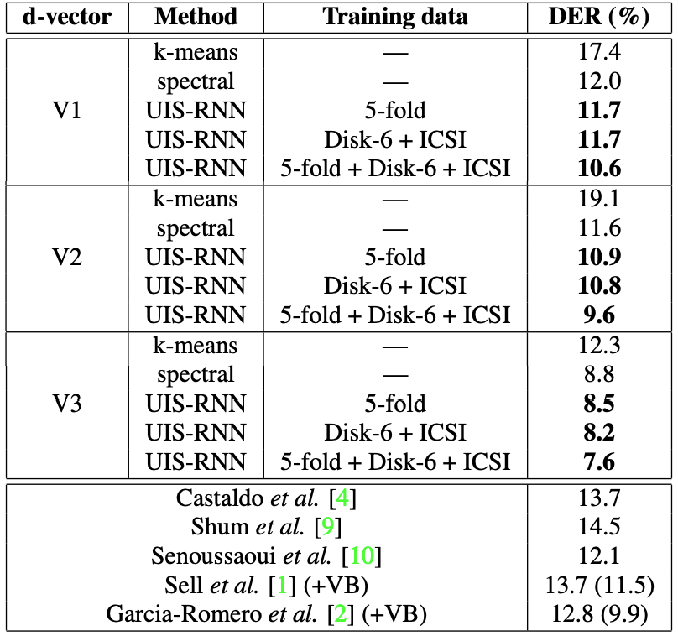
Diarization error rate (DER) results
What we can learn:
UIS-RNN outperforms k-means or spectral
Even if UIS-RNN is online!
UIS-RNN can benefit from increasing training data
Because it’s supervised!
Off-domain training also works
Quality of d-vector is important
Especially variable-length window training
We are state-of-the-art

Slide 40
Part 5:
The Python Library

Slide 41
The uis-rnn library
We open-sourced the UIS-RNN algorithm on GitHub
Available at: https://github.com/google/uis-rnn
Based on Python3 and PyTorch
Similar APIs with standard scikit-learn clustering algorithms
Unit tests and integration tests, with >90% coverage
Detailed documentation
PyPI packaging:
$ pip3 install uisrnn

Slide 42
APIs (v0.0.5)
Read arguments from command line (if none, use default):
Create a model:
Fit training data:
Run inference on testing data:
model_args, training_args, inference_args = uisrnn.parse_arguments()
model = uisrnn.UISRNN(model_args)
model.fit(train_sequences, train_cluster_ids, training_args)
predicted_cluster_id = model.predict(test_sequence, inference_args)

Slide 43
Data preparation
model.fit(train_sequences, train_cluster_ids, training_args)
train_sequences:
A list of observation sequences
Each observation sequence is an array of shape (length, dim)
The observations should be acquired using another speaker embedding library, such as i-vectors or d-vectors
train_cluster_ids:
A list of label sequences
Each label sequence is a list of strings
Each string is a speaker label

Slide 44
Arguments explained
--enforce_cluster_id_uniqueness
If train_sequences is a list of sequences, are their labels globally unique?
If not, we need to enforce uniqueness.
--test_iteration
We allow multi-pass decoding. If this value is larger than 1, it’s no longer online decoding.

Slide 45
FAQs
Can I directly feed in audio waveforms?
No. Inputs must be speaker-discriminative embeddings.
How do I compute embeddings?
There are lots of third-party libraries for computing embeddings.
You can pick one from here: https://wq2012.github.io/awesome-diarization
Which dataset should I use for training?
Any dataset that has timestamped speaker labels.
It should also be in the same domain that you want use for deployment.

Slide 46
FAQs
Your improvements are small, compared with spectral clustering?
But UIS-RNN decoding is online!!!
Please share your speaker recognition data/code/model?
Not that we are not willing to… But we really can’t.
Sensitive/proprietary data.
Internal dependencies.
Are the d-vectors generated by speaker recognition or UIS-RNN?
They are computed by speaker recognition network.
In UIS-RNN, we treat them as known observations, and try to generate them with a sequence generation network.

Slide 47
Part 6:
Conclusions and Future Work

Slide 48
Conclusions
Our contributions in this paper:
UIS-RNN: A trainable model for segmenting and clustering temporal data by learning from examples
A framework for fully supervised speaker diarization
New state-of-the-art performance on CALLHOME benchmark
Online diarization with offline quality

Slide 49
Future work
Speaker change:
Current coin flipping process is too simple. May replace with an RNN.
Speaker assignment:
𝛂 is a constant. Can we make it a distribution?
Training:
Make use of unlabeled data as part of the training set.
Decoding:
Further improve performance by offline decoding: a quality-latency tradeoff.

Slide 50
Questions?

